Slide 1
Instructions for Manuscript Submission
Notes:
Slides 1-51
Phần 2: 52-222

Slide 2

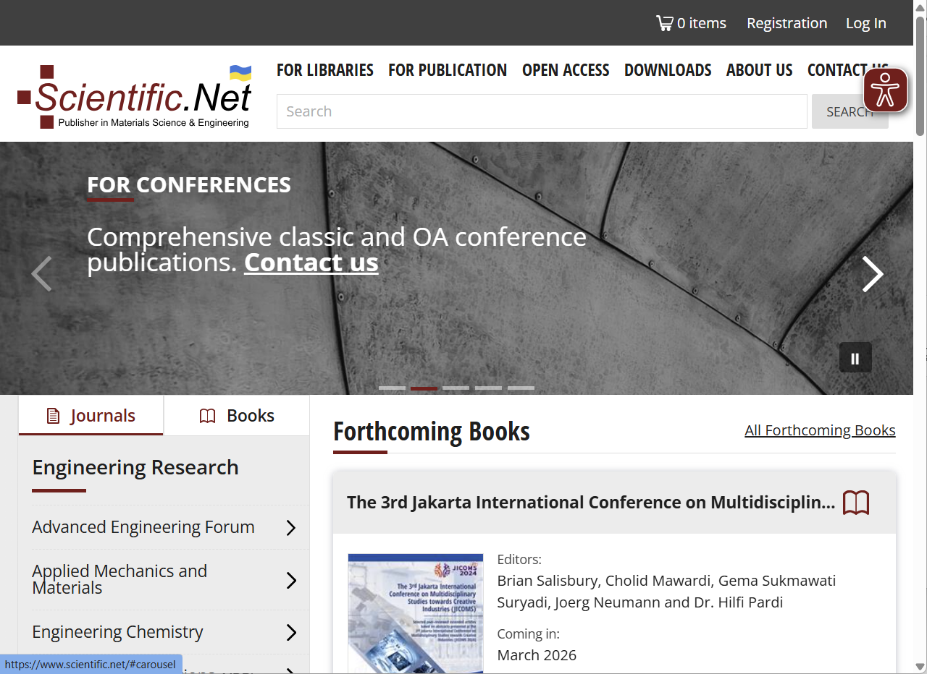
Access the Scientific.Net login page – scientific.net

Slide 3
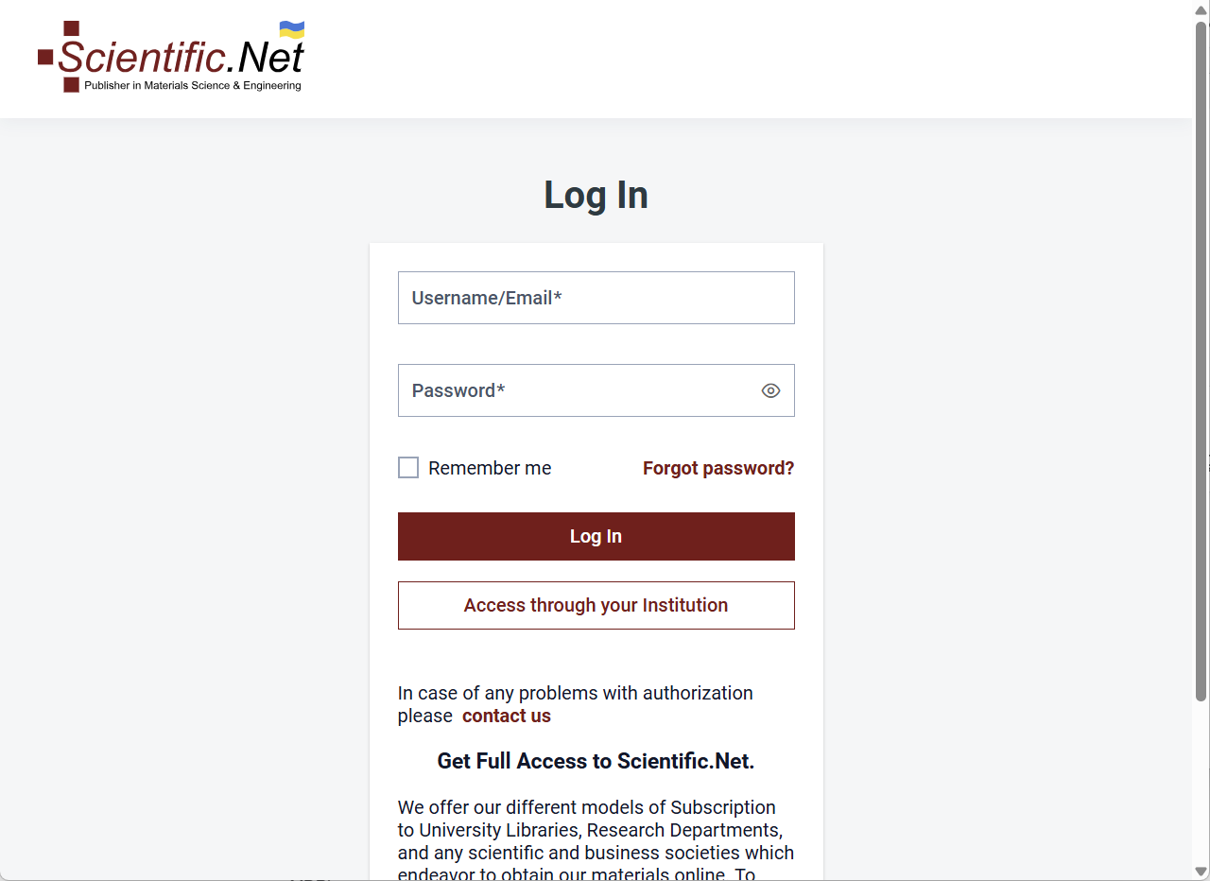
Log in using your Scientific.Net account
https://idp.scientific.net/login

Slide 4
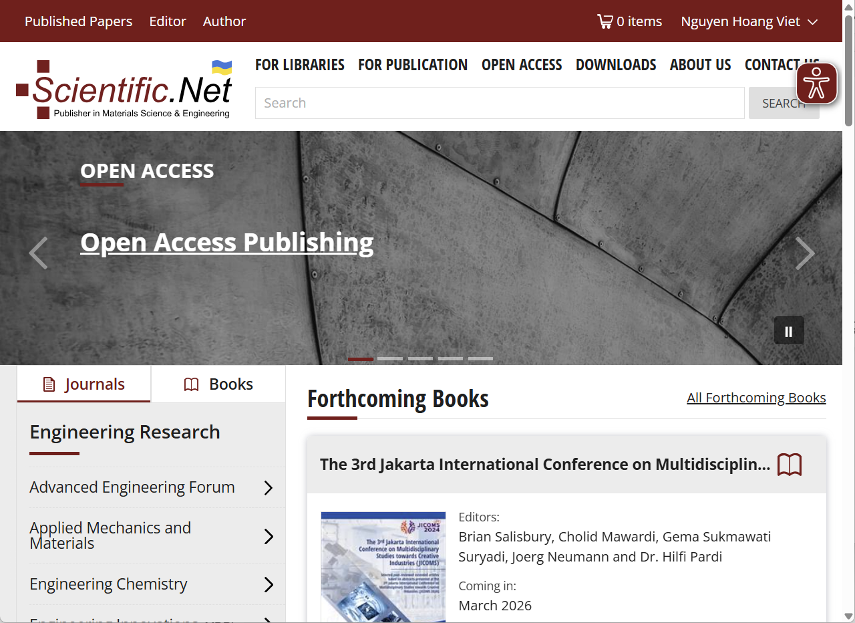
Navigate to the Author Dashboard
https://main.scientific.net/editing-tool/author/home

Slide 5
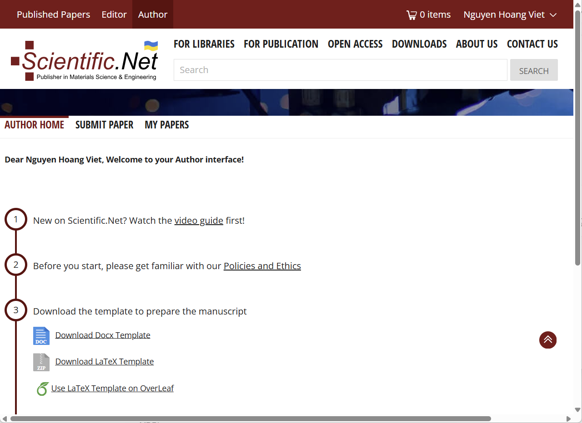

Select Author area
https://main.scientific.net/editing-tool/author/home
Use the Scientific.Net Word or LaTeX template for manuscript preparation

Slide 6
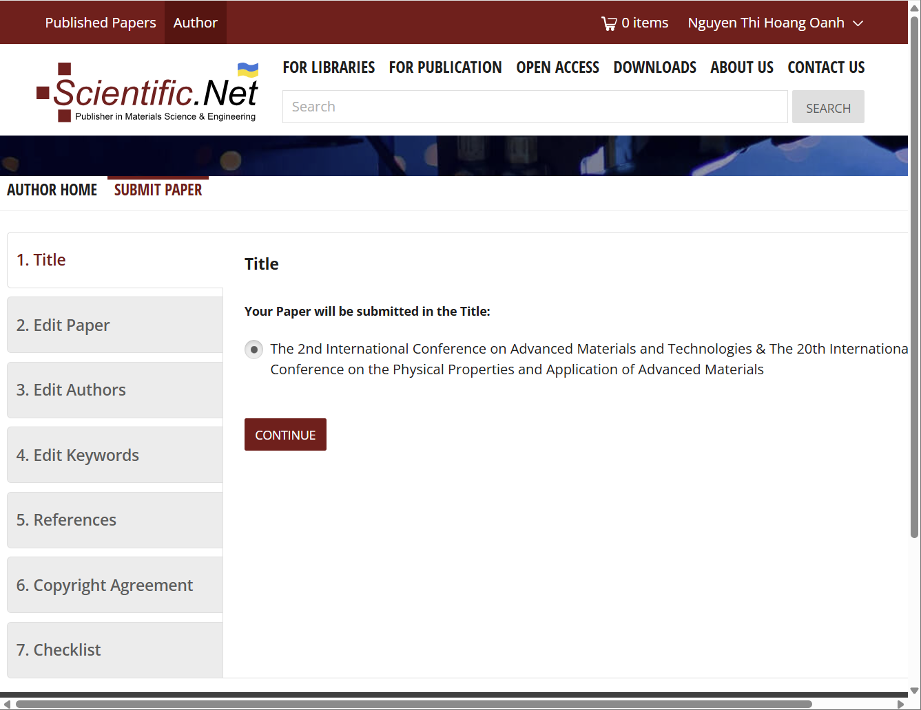


Step by step to submit your manuscript
https://main.scientific.net/editing-tool/author/home

Slide 7
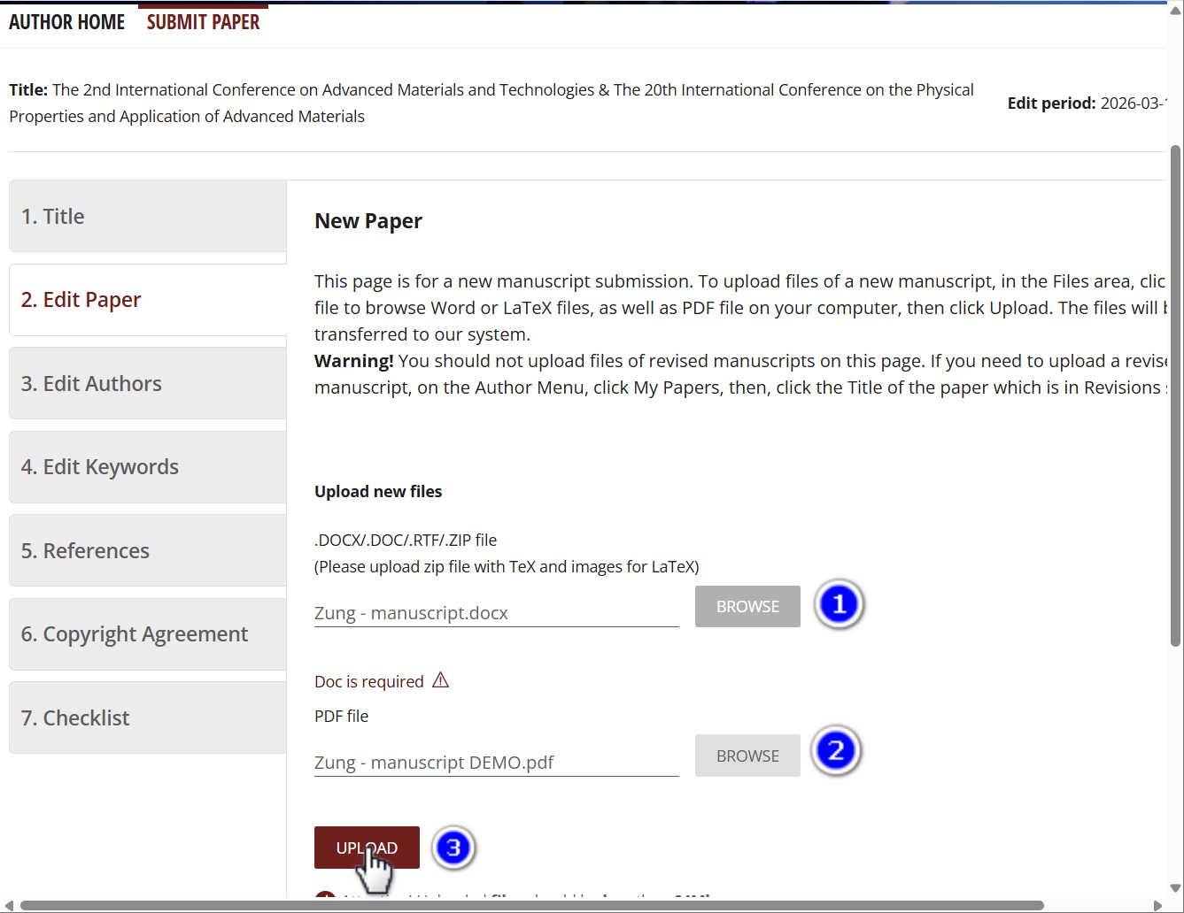
Step by step to submit your manuscript
https://main.scientific.net/editing-tool/author/home
Upload your manuscript
(1) Browse your Word or LaTeX source file
(2) Browse the corresponding PDF file
(3) Click “Upload” to submit your manuscript

Slide 8
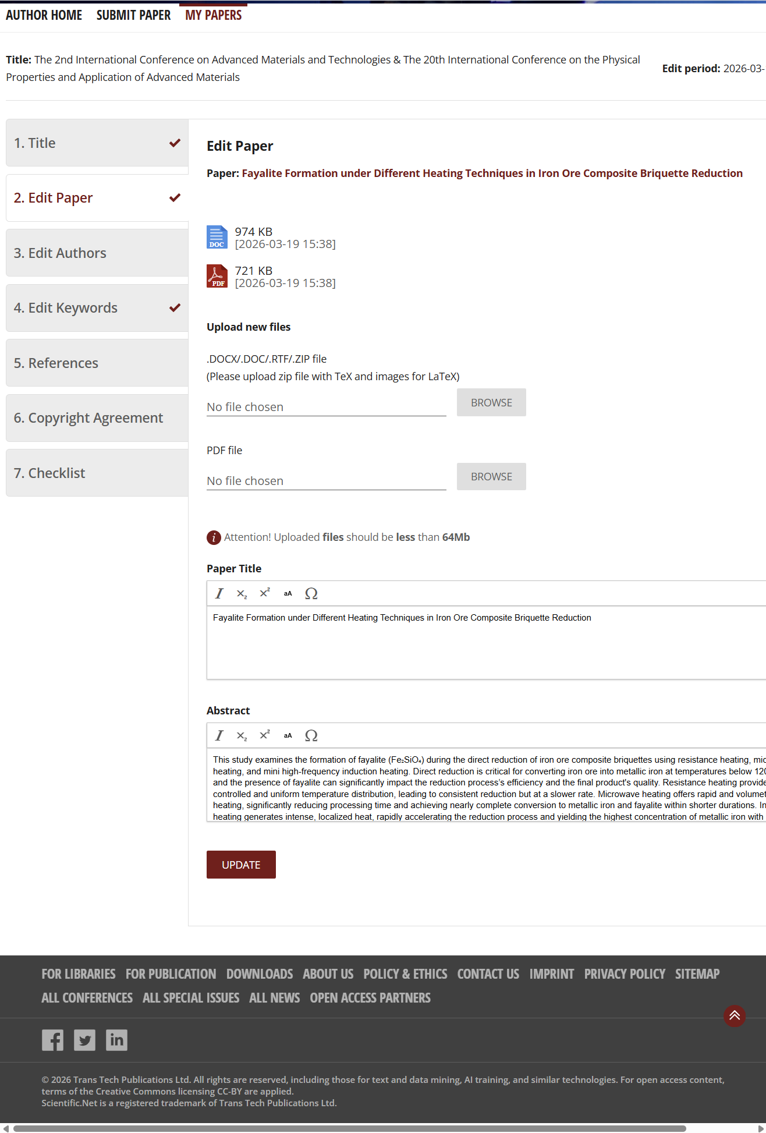
Step by step to submit your manuscript
https://main.scientific.net/editing-tool/author/home
Verify your manuscript details
Check the title and abstract for accuracy

Slide 9
Step by step to submit your manuscript
https://main.scientific.net/editing-tool/author/home
Verify your manuscript details
Check your Title
Check your Abstract

Slide 10
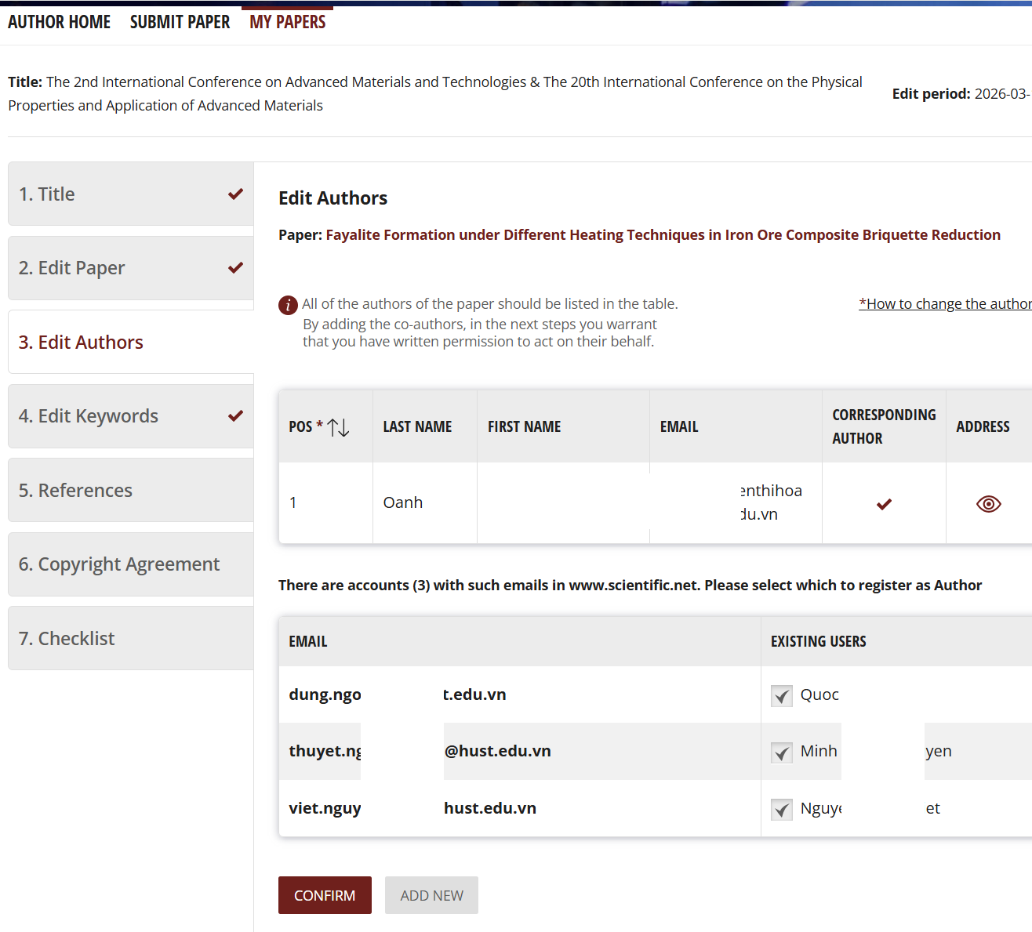
Step by step to submit your manuscript
https://main.scientific.net/editing-tool/author/home
Verify your manuscript details
Verify the corresponding author
Confirm the author list

Slide 11
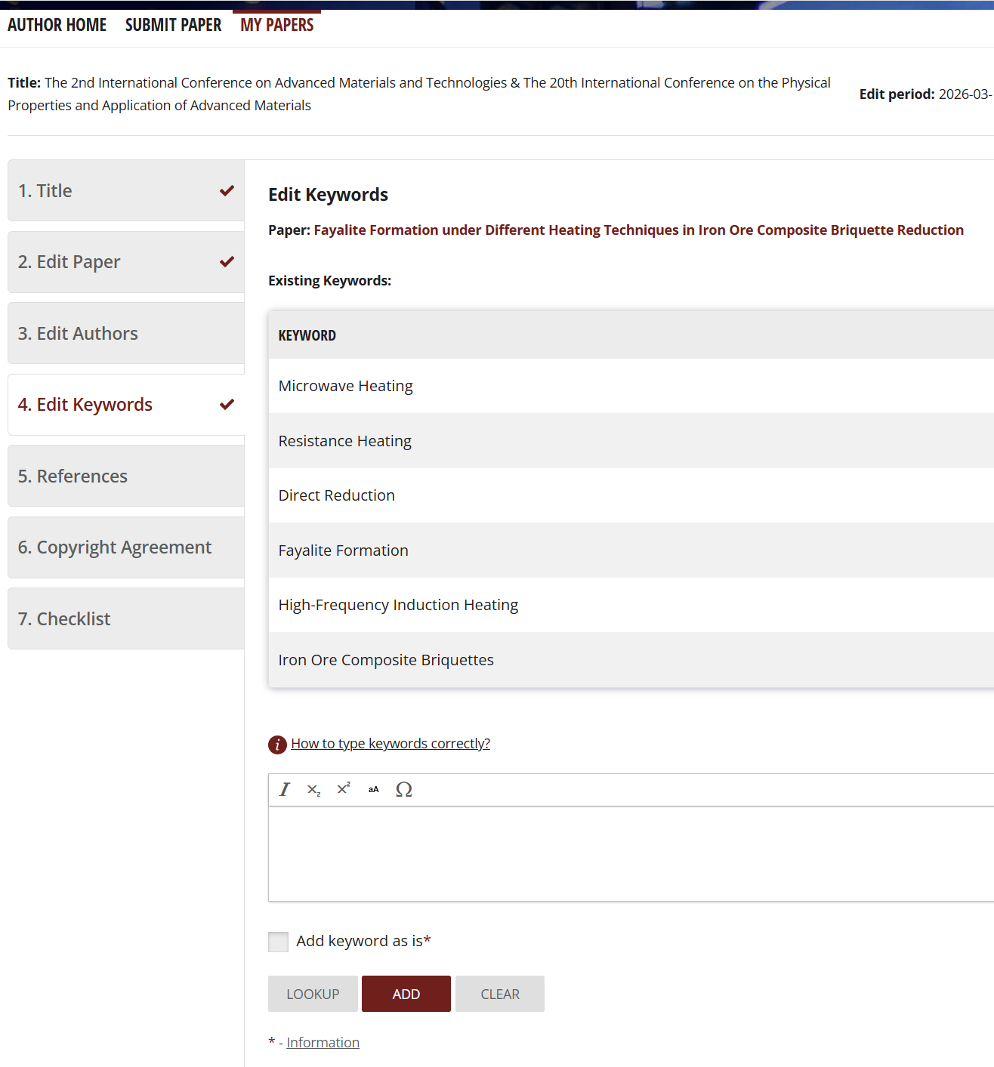
Step by step to submit your manuscript
https://main.scientific.net/editing-tool/author/home
Verify your manuscript details
Review the keyword list
Add additional keywords if necessary

Slide 12
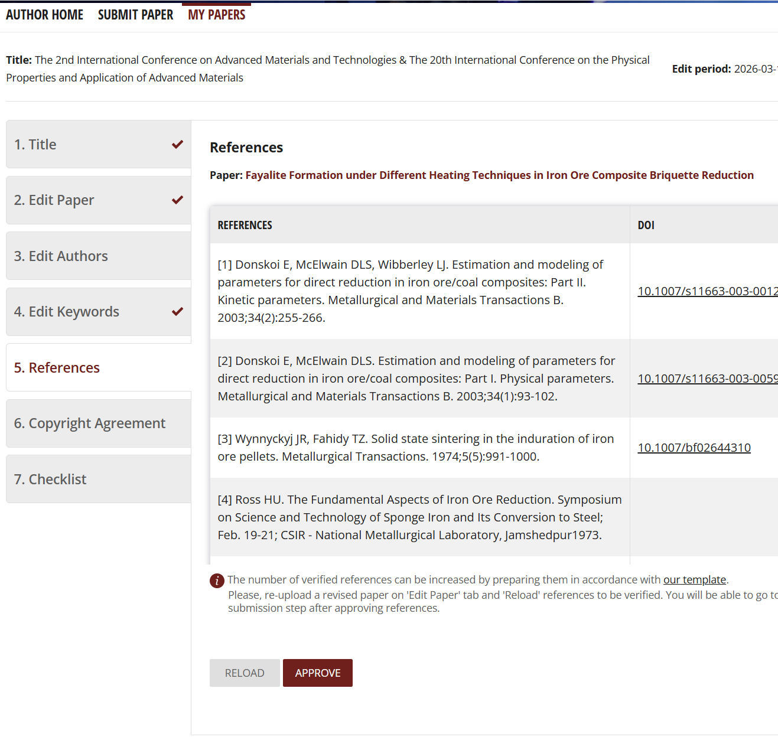
Step by step to submit your manuscript
https://main.scientific.net/editing-tool/author/home
Verify your manuscript details
The reference list is automatically generated and cannot be edited manually
Once approved, the reference list cannot be modified.

Slide 13
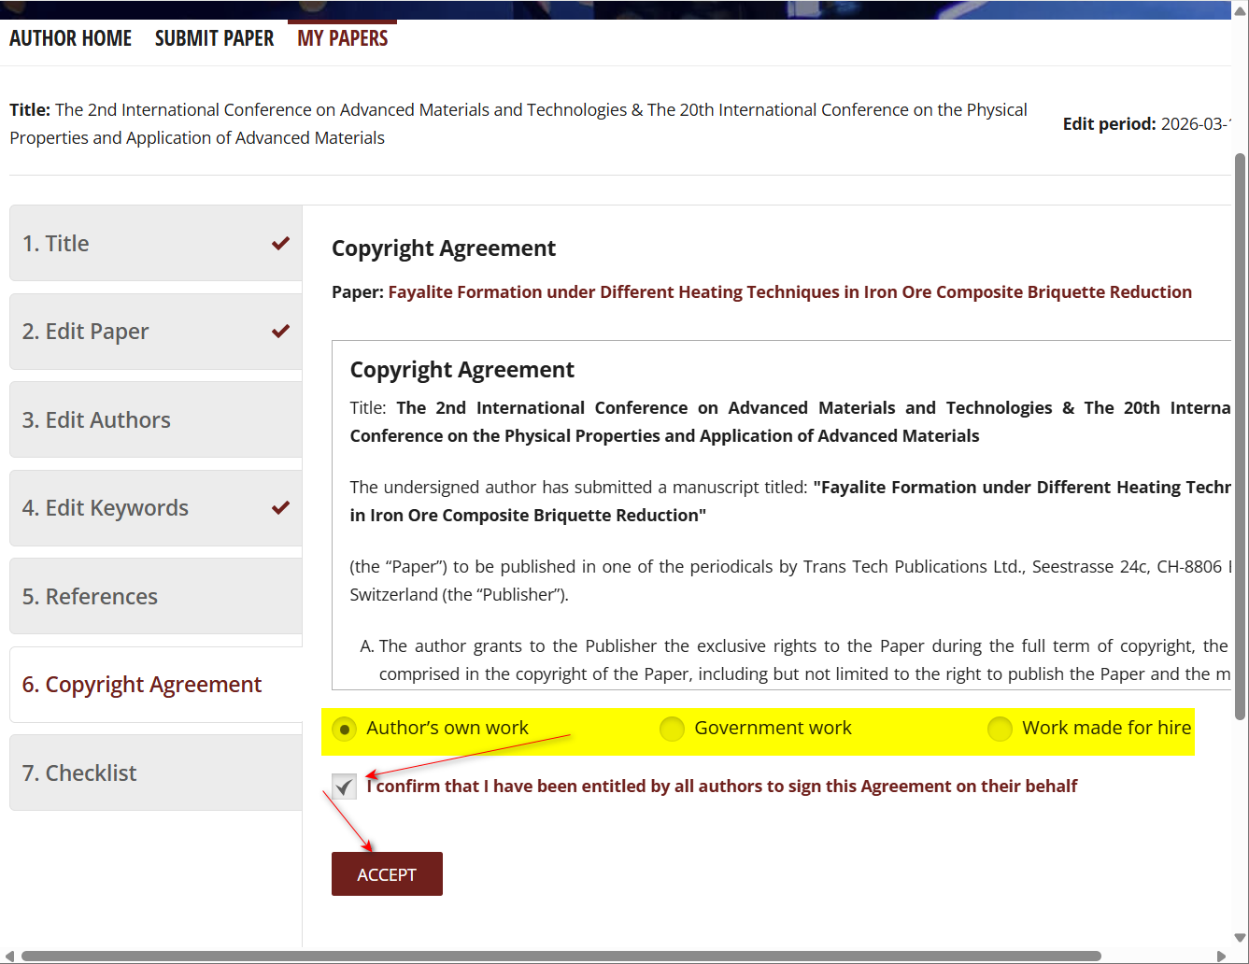
Step by step to submit your manuscript
https://main.scientific.net/editing-tool/author/home
Verify your manuscript details
Select and confirm the appropriate manuscript type
This is an example of selection

Slide 14
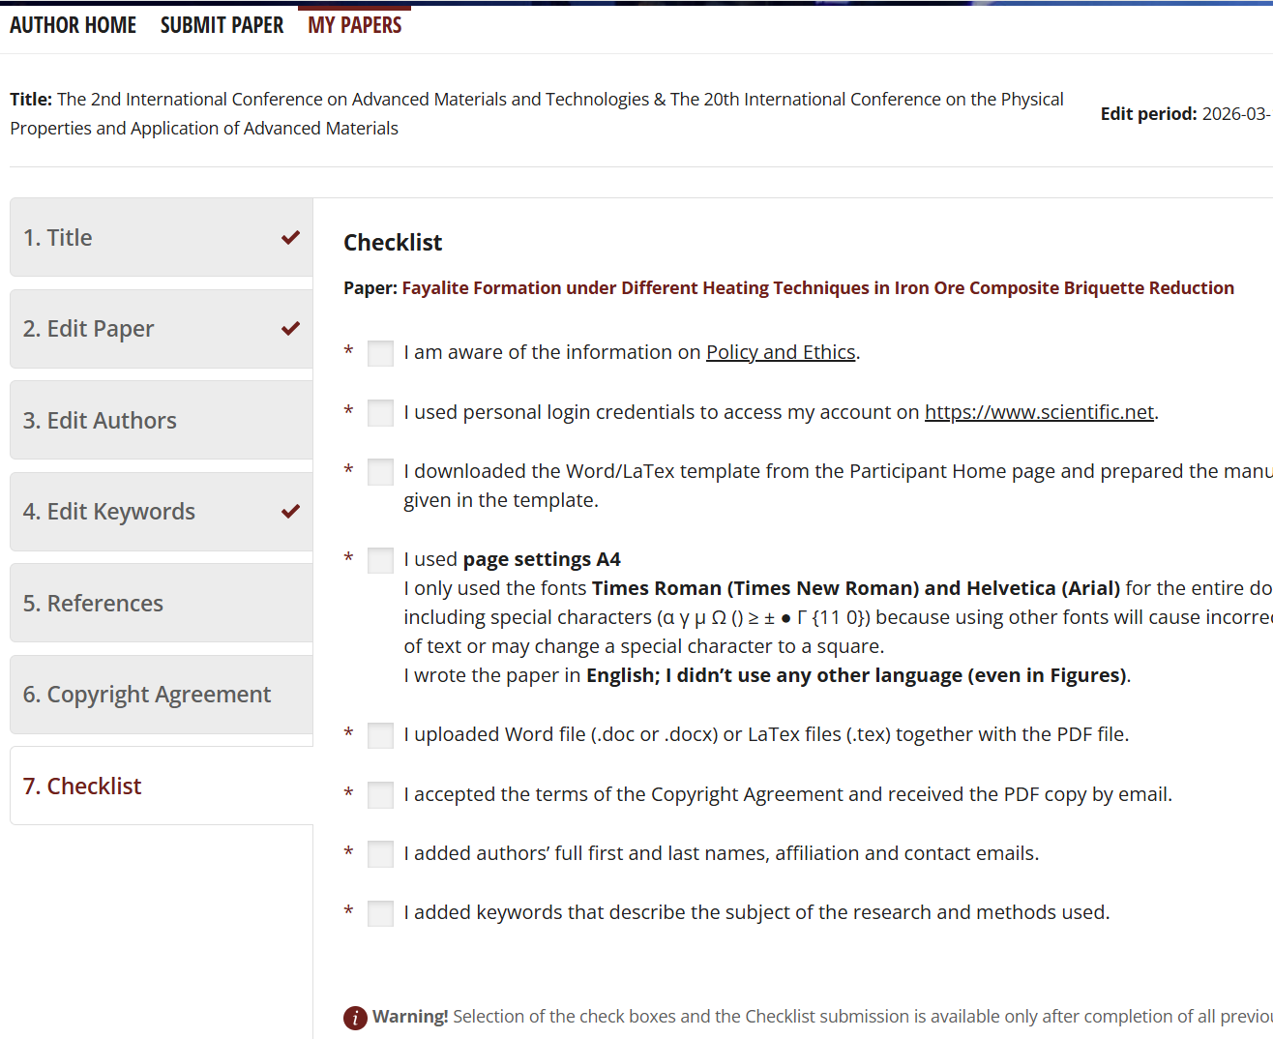
Step by step to submit your manuscript
https://main.scientific.net/editing-tool/author/home
Verify your manuscript details
Only proceed after completing all the above steps:
“Tick the confirmation box to finalize submission”

